Slide 1
Variable Length Subnet Mask
Course Code: CSC 3116
Course Title: Computer Networks
Dept. of Computer Science
Faculty of Science and Technology
Lecturer No: | Lab 4 | Week No: | 3 | Semester: | Fall 24-25
Lecturer: | Dr. Mehedi Hasan; mmhasan@aiub.edu

Slide 2
Lecture Outline
Introduction
VLSM
Steps of VLSM
Example 1
Example 2
3. Homework

Slide 3
Introduction
Problems of Large Network
A large network is difficult to manage
Less security as each host of the network can reach all other hosts.
Huge broadcast domain, thereby large bandwidth consumption
Waste of unused IP addresses

Slide 4
Introduction….
How to overcome the problems?
Dividing a large network into several smaller networks, called subdivided networks or subnets.

Slide 5
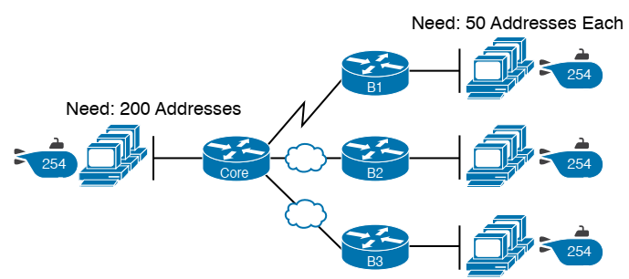
Introduction….
For classful addressing
Network | No. of IP addresses allocated
A | 256
B | 256
C | 256
D | 256
E | 256
F | 256
G | 256
Network: E
Required IP: 5
Network: A
Required IP: 56
B
C
Network: F
Required IP: 21
D
Network: G
Required IP: 26

Slide 6
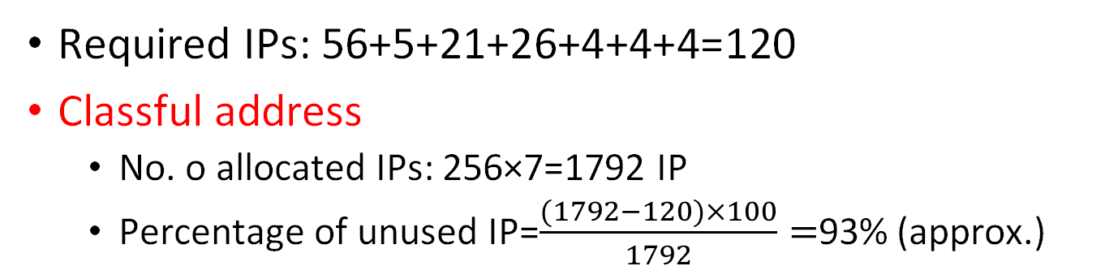
Introduction
Required IPs: 56+5+21+26+4+4+4=120
Classful address
No. o allocated IPs: 256×7=1792 IP
Percentage of unused IP=$\frac{(1792−120)×100}{1792}=$93% (approx.)

Slide 7
Introduction
Is there any way to further reduce the unused IP addresses?
Yup!
Instead of giving the same number of IP addresses to all subnets,
allocate different number of IP addresses depending
on each subnet’s needs.

Slide 8
VLSM
Variable Length Subnet Mask (VLSM)
Instead of allocating the same number of IP addresses to all networks, the number of IP addresses allocated to network depends on the network’s need.
Different network is provided with different number of IPs

Slide 9
VLSM
Steps of VLSM
Step 1: Write the networks’ names and IP requirements in descending order of IP requirements.
A (56), G(26), F(21), E(5), B(4), C(4), D(4)
Step 2: Find the number of host bits needed to satisfy the IP requirement of each subnet?
Step 3: Based on the number of host bits, find the subnet mask for each subnet.
Step 4: Allocate IPs to each subnet starting from the beginning of the IP block. Allocate IPs to subnet sequentially according to the sorted network sequence found in Step 1.

Slide 10
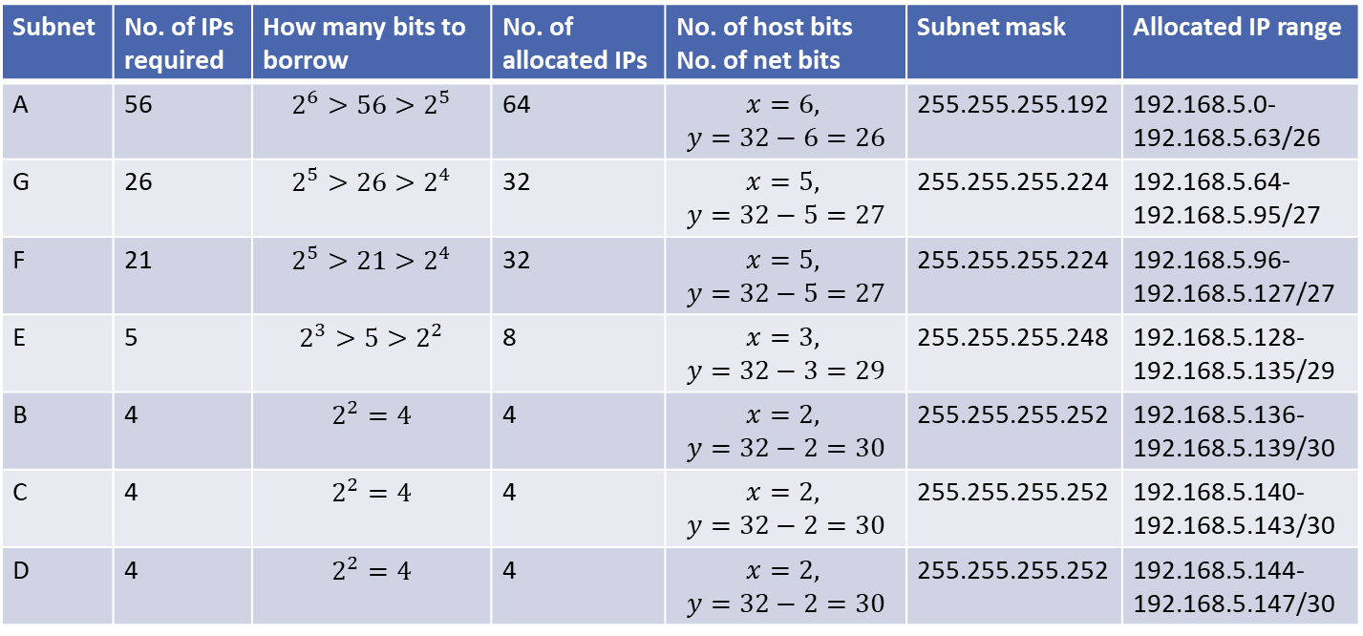
VLSM….
Example 1
11111111. 11111111. 11111111. 11000000
26
6
Subnet | No. of IPs required | How many bits to borrow | No. of allocated IPs | No. of host bits No. of net bits | Subnet mask | Allocated IP range
A | 56 | $$2^{6}>56>2^{5}$$ | 64 | $$x=6,$$ $$y=32−6=26$$ | 255.255.255.192 | 192.168.5.0-192.168.5.63/26
G | 26 | $$2^{5}>26>2^{4}$$ | 32 | $$x=5,$$ $$y=32−5=27$$ | 255.255.255.224 | 192.168.5.64-192.168.5.95/27
F | 21 | $$2^{5}>21>2^{4}$$ | 32 | $$x=5,$$ $$y=32−5=27$$ | 255.255.255.224 | 192.168.5.96-192.168.5.127/27
E | 5 | $$2^{3}>5>2^{2}$$ | 8 | $$x=3,$$ $$y=32−3=29$$ | 255.255.255.248 | 192.168.5.128-192.168.5.135/29
B | 4 | $$2^{2}=4$$ | 4 | $$x=2,$$ $$y=32−2=30$$ | 255.255.255.252 | 192.168.5.136-192.168.5.139/30
C | 4 | $$2^{2}=4$$ | 4 | $$x=2,$$ $$y=32−2=30$$ | 255.255.255.252 | 192.168.5.140-192.168.5.143/30
D | 4 | $$2^{2}=4$$ | 4 | $$x=2,$$ $$y=32−2=30$$ | 255.255.255.252 | 192.168.5.144-192.168.5.147/30

Slide 11
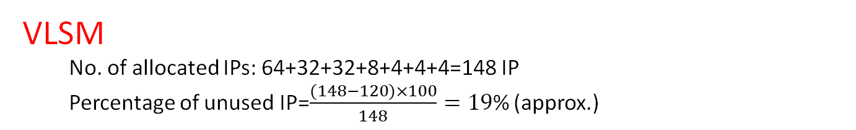
VLSM….
Example 1
VLSM
No. of allocated IPs: 64+32+32+8+4+4+4=148 IP
Percentage of unused IP=$\frac{(148−120)×100}{148}=19$% (approx.)
Percentage of unused IP address (for the given network)
Classful Addressing | VLSM
93% | 19%

Slide 12
VLSM….
Is it possible to further reduce the unused IP?
Spend your time to propose a new subnetting technique.

Slide 13
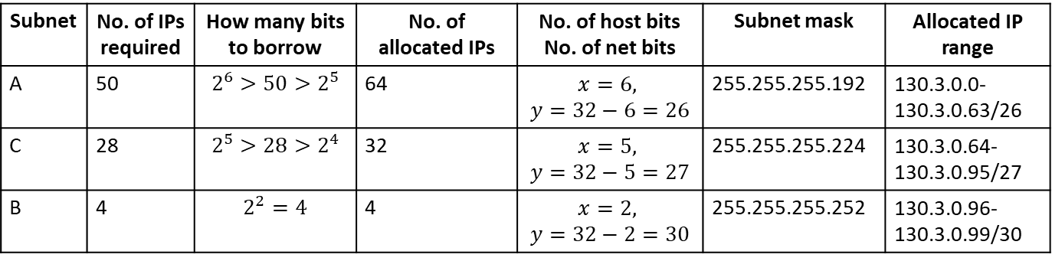
VLSM….
Example 2
Suppose that we have three networks: A, B and C with IP requirements 50, 4 and 28. If You are given an IP block 130.3.0.0, allocate IPs performing subnetting.
Subnet | No. of IPs required | How many bits to borrow | No. of allocated IPs | No. of host bits No. of net bits | Subnet mask | Allocated IP range
A | 50 | $$2^{6}>50>2^{5}$$ | 64 | $$x=6,$$ $$y=32−6=26$$ | 255.255.255.192 | 130.3.0.0-130.3.0.63/26
C | 28 | $$2^{5}>28>2^{4}$$ | 32 | $$x=5,$$ $$y=32−5=27$$ | 255.255.255.224 | 130.3.0.64-130.3.0.95/27
B | 4 | $$2^{2}=4$$ | 4 | $$x=2,$$ $$y=32−2=30$$ | 255.255.255.252 | 130.3.0.96-130.3.0.99/30

Slide 14
Lab Task
Suppose that we have three networks: A, B and C with IP requirements 100, 300 and 2008, respectively. If You are given an IP block 130.3.0.0, allocate IPs performing subnetting.
Suppose that we have six networks: A, B, C, D, E and F with IP requirements 120, 400, 9, 40, 32, and 7, respectively. If You are given an IP block 210.3.0.0, allocate IPs performing subnetting.
Consider your ID: AB-CDEFG-H. Now, suppose that we have four networks: P, Q, R, and S with IP requirements D*100, E*100, F*100, and G*100, respectively. If You are given an IP block 172.16.0.0/16, allocate IPs performing subnetting.

Slide 15
References
1. Official Cert Guide CCNA 200-301 , vol. 1, W. Odom, Cisco Press, First Edition, 2019, USA.
2. CCNA Routing and Switching, T. Lammle, John Wily & Sons, Second Edition, 2016, USA.

Slide 16
Recommended Books
1. Official Cert Guide CCNA 200-301 , vol. 1, W. Odom, Cisco Press, First Edition, 2019, USA.
2. CCNA Routing and Switching, T. Lammle, John Wily & Sons, Second Edition, 2016, USA.

